Slide 1
Prevention of Accidents
Dr. Asanga Wickramasinghe

Slide 2
Objectives
To describe the public health impact of accidents
To describe risk factors for accidents
To describe strategies for prevention of accidents

Slide 3
What is an accident
An accident which leads to sequence of events, and usually produces unintended
- injury
- death
- damage to the property

Slide 4
What is an injury?
Defined as bodily lesions at the organic level, resulting from unintentional intentional acute exposure to energy (mechanical, thermal, electrical, chemical or radiant) or the insufficiency of vital elements (e.g, oxygen) that exceed the threshold of physiological tolerance (Baker et al,1992)

Slide 5
Classification of accidents
Natural/ unnatural
Place (Land/Air/Water-Aquatic)
Place ( Home, Road, Workplace, Sports)
Age (Preschool, Teen, Youth, Adult, Elderly)
Consequences (Minor, Major,Mass)

Slide 6
Classification of accidents… based on the agents
Fire Water
Firearm Poison
Electricity Machinery
Vehicle Animals
Building

Slide 7
Global burden Disease burden (DALYS) for the 10 leading causes
1999
Disease or injury
2020
Disease or injury
Lower respiratory infections
HIV/AIDS
Perinatal conditions
Diarrhoeal diseases
Unipolar major depression
Ischemic heart diseases
Cerebrovascular diseases
Malaria
Road traffic injories
Chronic obstructive pulmonary diseases
Ischemic heart diseases
Unipolar major depression
Road traffic accidents
Cerebrovascular diseases
Chronic obstructive pulmonary diseases
Lower respiratory infections
Tuberculosis
War
Diarrhoeal diseases
HIV/AIDS

Slide 8
What is An Accident ?
Accident is an undesired or unintended happening. Inevitable accident falls within the concept of ACT OF GOD OR DAMNUM FATALE OR an Unfortunate harmful event, event without apparent cause unexpected occurring. (https://www.police.lk/index.php/traffic-police/56)

Slide 9
A Motor Traffic Accident occurs on highway collision with Vehicles, persons or with property.
Vehicle is defined in section 240 of the Motor Traffic Act.
Vehicle includes bicycles, tricycles, motor vehicles, vehicles of every description, pedestrians, processions, and bodies of troops, and all animals being ridden, driven or led.

Slide 10
An Accidents may occur
i. between a vehicle and other vehicle.
ii. Vehicle colliding with a person
iii. Vehicle colliding with movable or unmovable property
iv. When a Vehicle goes off the road
v. A person being knocked down with another person.
vi. Due to natural or man made disaster

Slide 11
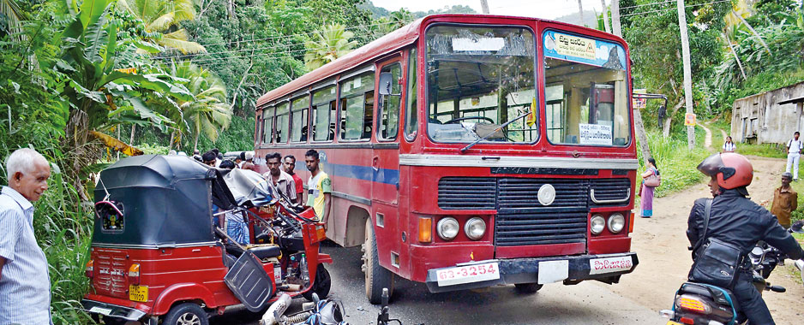

Slide 12
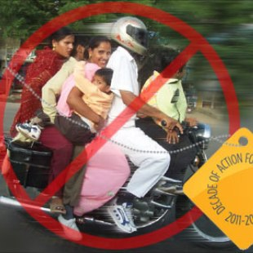

Slide 13
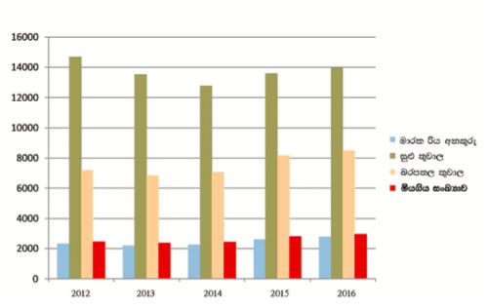

Slide 14
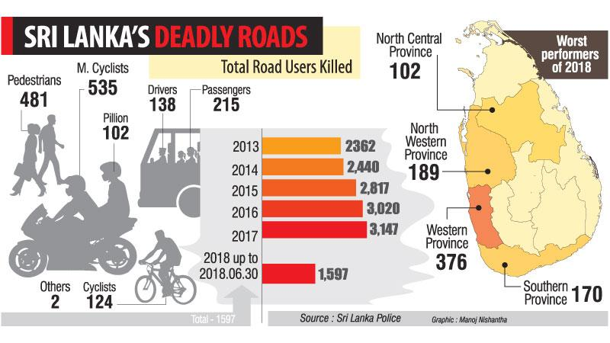

Slide 15
Road traffic injuries – Sri Lankan situation
In the year 2000- 54,239 road trafficcrashes were reported, killing 2,150 people and injuring 19,835(TP data)
Daily – 6 people are killed
Every hour – 2 are injured
Every 10 minutes – a RTC is reported
About 40% to 50% of the injured and killed are pedestrians ?poor people

Slide 16
No. of persons injured (Grievous & Non Grievous injury) in Road traffic Accidents
year | No. of injuries
2000 | 19835
2006 | 22532
2010 | 26847
2017 | 33452

Slide 17
Number of deaths in road accients
Year | No. of deaths
2000 | 2150
2008 | 2328
2010 | 2721
2016 | 3017
2017 | 3147
2018 | 3164

Slide 18
Road traffic injuries- Sri Lankan situation
Unreported crashes- no information
25% of fatal RTCs are not reported
(Wooton J et al 1996)

Slide 19
RTA – A public health problem
Hospital level
13- 31% of all injury
30-86% of bed occupancy in surgical wards
Mean hospital stay – 20 days

Slide 20
RTA- A public health problem
Increased usage of
Operating theaters
ICU
Radiology departments
Physiotherapy unit
Rehabilitation services

Slide 21
RTA – A public health problem
Individual leval
Cost of health care and rehabilitation
Permanent disability (paraplegia)
Dependence on others (financial support & physical care)
Chronic physical pain
Permanent disfigurement (Serious burns, contusions, laceration)
Emotional trauma

Slide 22
RTA- problems ctd…
Community level
Health care expenses
Compensations
Insurance
Loss of work force
Police
Courts
Prison

Slide 23
Risk factors for accidents
Human factors
Age
Sex
Education
Fatigue
Mechanical conditions- acute and chronic
- Heart attack
- Impaired vision
Lack of body protection
Psycho- social and behavioral factors

Slide 24
Psycho social and behavioral factors
Lack of experience
Risk taking
Impulsiveness
Defective judgment
Delay in decision
Aggressiveness
Poor perception
Family dysfunction

Slide 25
Environmental factors -Condition of roads -Condition of vehicles -Weather condition -Slow and fast moving vehicles -Pedestrians -Animals Other factors Lack of enforcement of law Economical factors

Slide 26
Risk factors associated with RTI
Individual
-Male gender , youth
-Substance abuse
-Speeding
-Not wearing seat belt or helments
-Mobile phones
-Inconspicuousness of vulnerable road uses
-Lac of experience
-Sleep disorders

Slide 27
Risk factors associated with RTI
Vehicle
-absence of seat belt
-condition of the vehicle
Environmental
-speed
-multiple users
-speed cameras
-traffic congestion

Slide 28
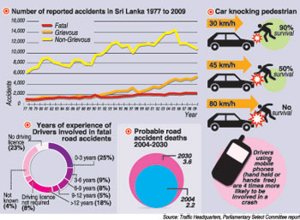

Slide 29
Prevention of accidents and injuries
Identification of risk factors
Safety education and personal protective equipments
Promotion of safety measures
Control of alcohol and other drugs
Enforcement of law
Emergency care and management
Rehabilitation services
Reserch

Slide 30
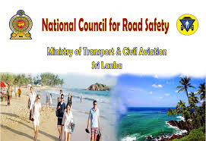

Slide 31
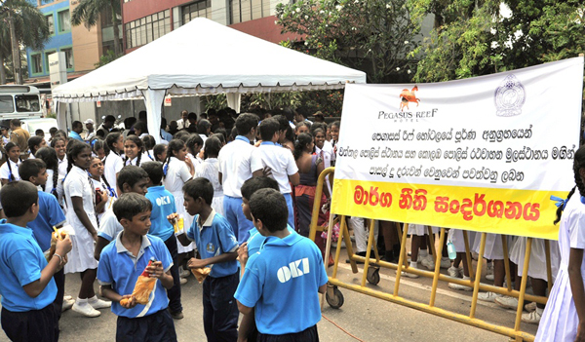

Slide 32
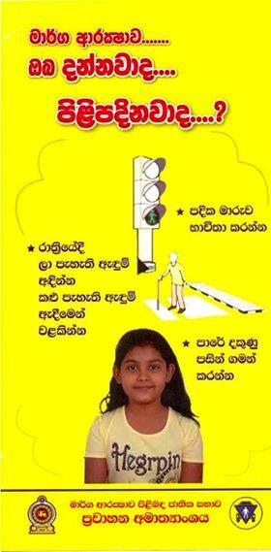

Slide 33
THANK YOU

